Slide 1
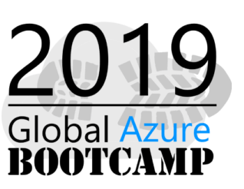





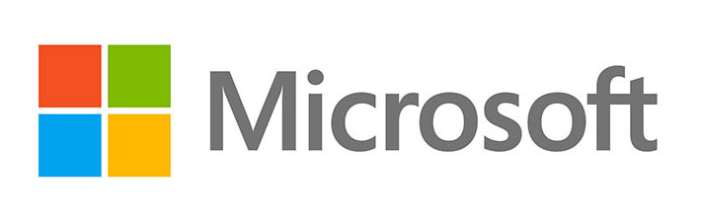


Sponsors for Azure Bootcamp

Slide 2
Getting Started with Machine Learning using Spark in Azure HDInsight
Ingyu Lee
Troy University
https://github.com/Azure-Bootcamp-Troy/SparkOnHDInsight

Slide 3
Content
What is Spark on HDInsight?
Demo: Create Spark Cluster on Azure
What is an RDD, DataFrames, Spark SQL?
Demo: Operations of RDD, DataFrames and SQL
What is MLlib?
Demo: Machine Learning using Spark
For Whom this talk
Business users to analyze Big Data using Spark on Azure Cluster.
Prerequisite
None

Slide 4
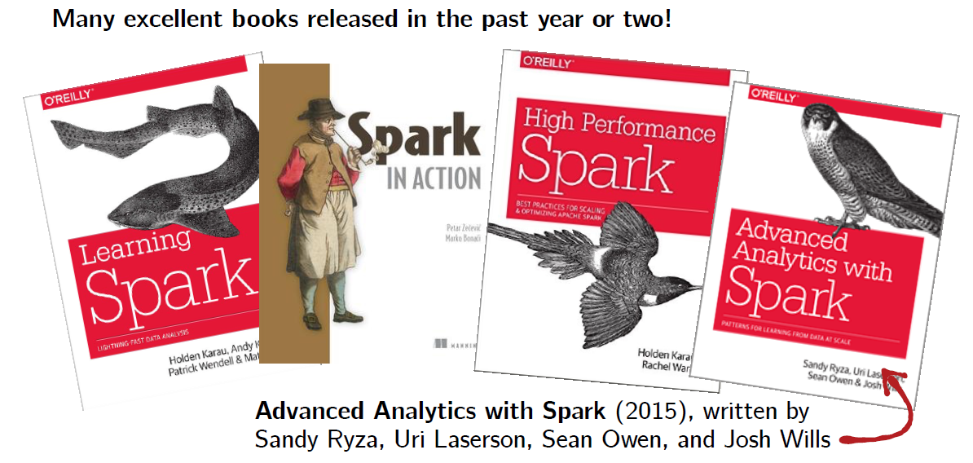
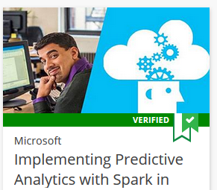
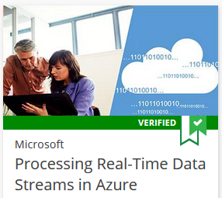
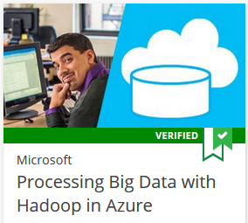
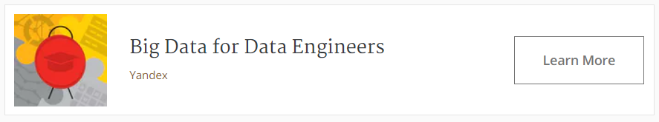
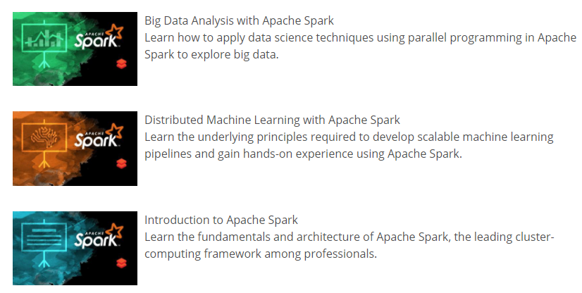
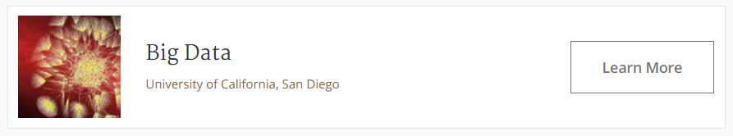
References
This talk is based on this course

Slide 5
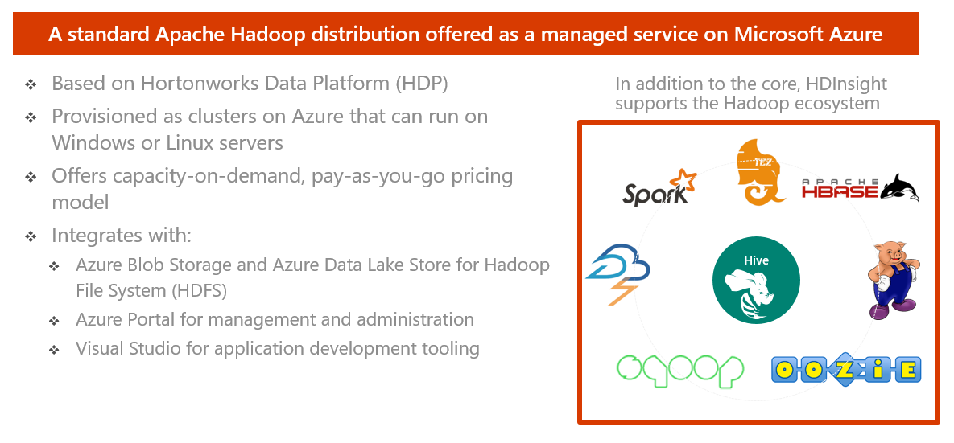
HDInsight – What is it?

Slide 6
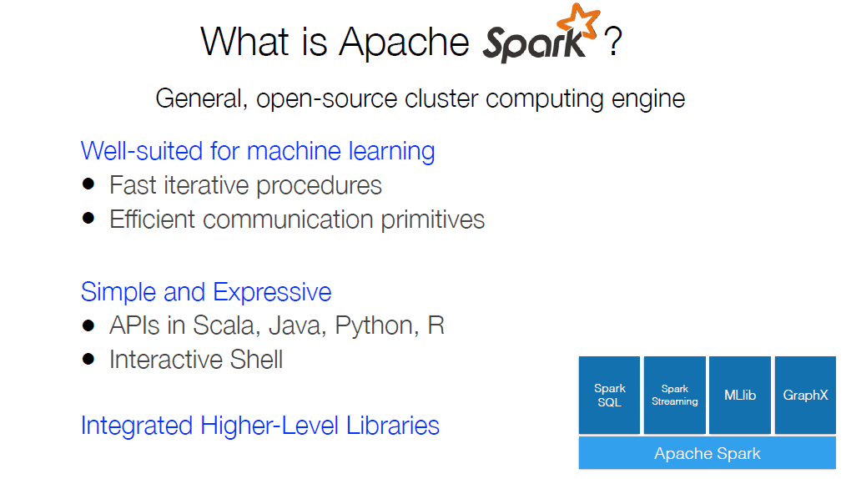
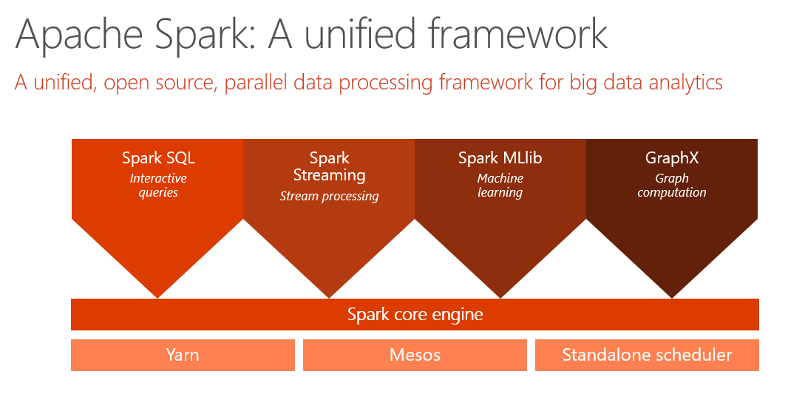

Slide 7
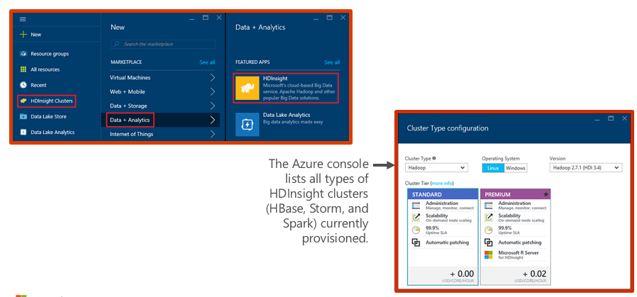
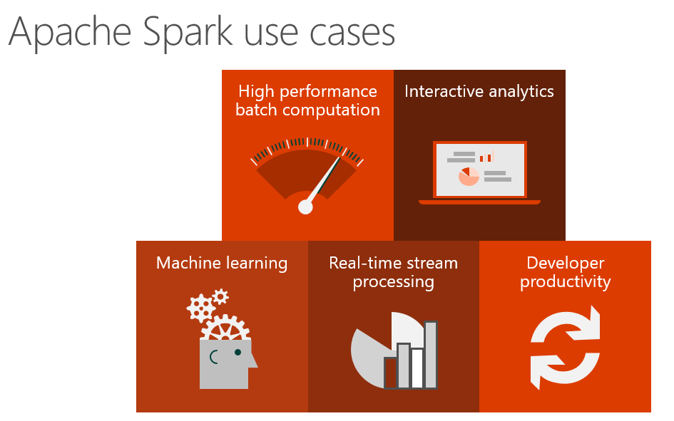
Demo: Creating an HDInsight Spark cluster

Slide 8
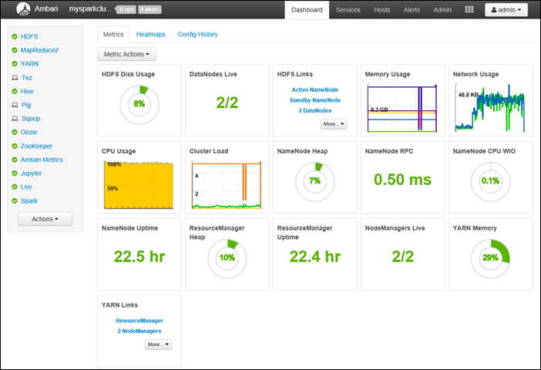
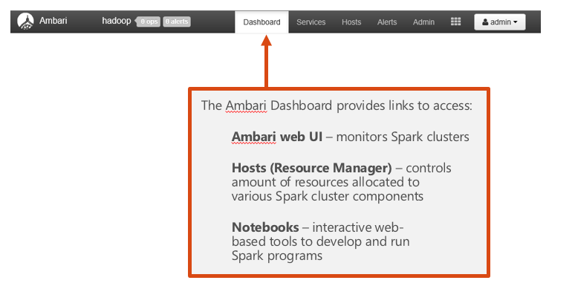
Demo: Ambari Dashboard

Slide 9
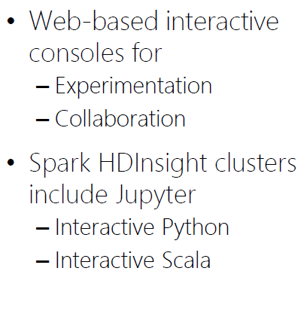
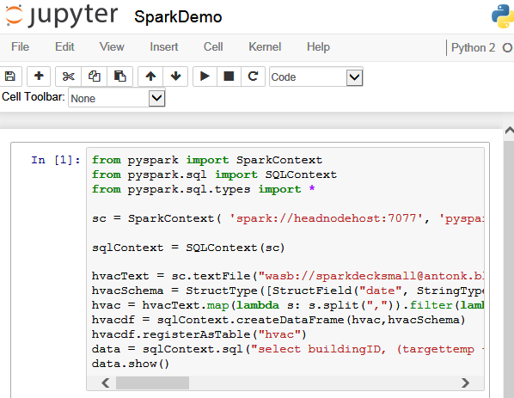
Demo: Jupyter notebooks

Slide 10
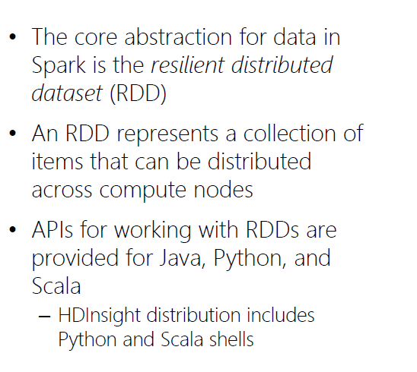
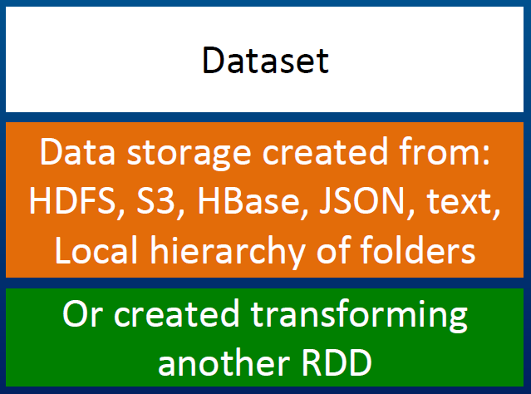
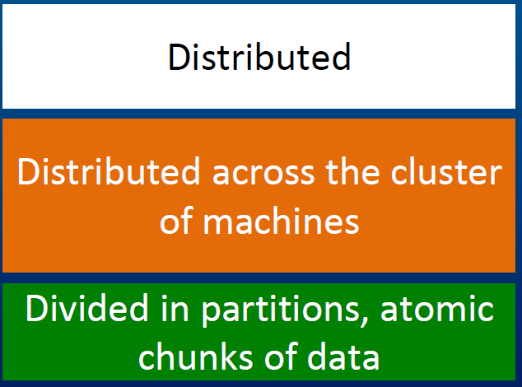
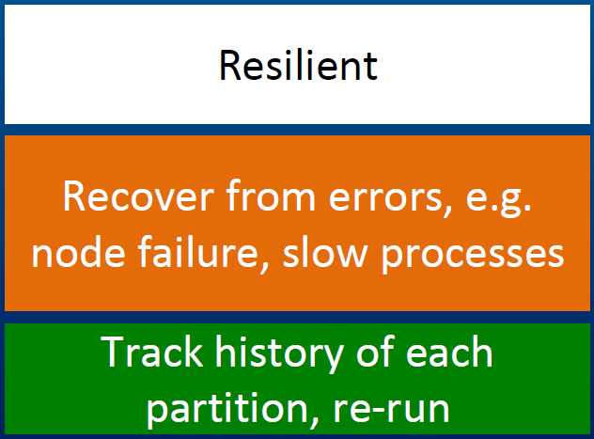
What is RDD?
Resilient Distributed Datasets or RDDs address this by enabling fault-tolerant, distributed, in-memory computations.

Slide 11
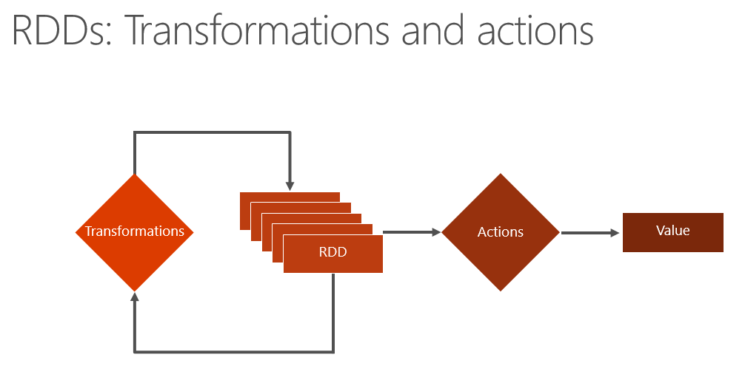
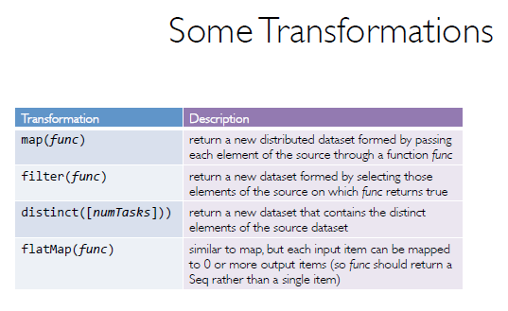
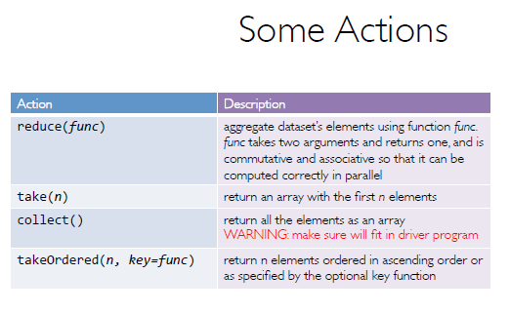
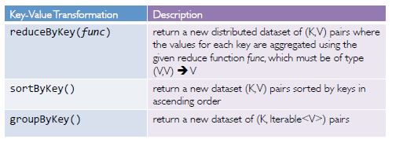
RDD Operations

Slide 12
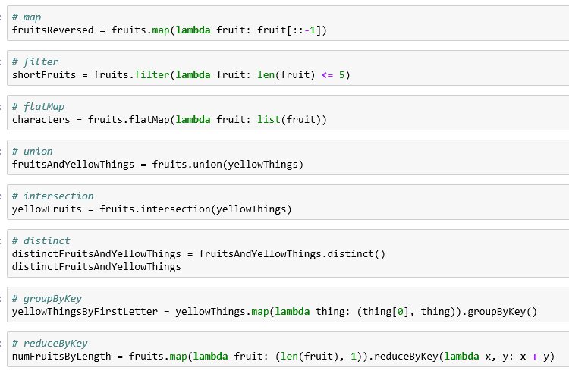
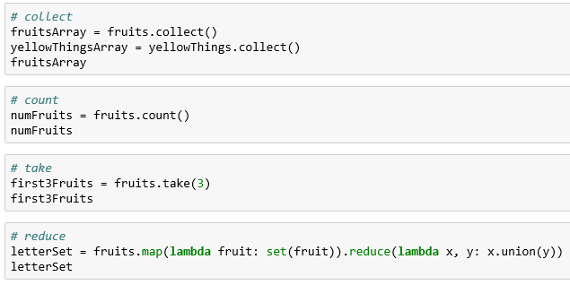
Demo: RDD
RDDs can be created from stable storage or by transforming other RDDs.
Transformations create a new dataset from an existing one. Transformations are lazy, meaning that no transformation is executed until you execute an action.
Actions return a value to the driver program after running a computation on the dataset.

Slide 13
What is DataFrames?
A distributed collection of data organized into named columns.
Similar to RDDs with schema.
Conceptually equivalent to tables in relational database, or to DataFrames in R/Python.
With domain-specific functions designed for common tasks:
Metadata
Sampling
Project, filter, aggregation, and join
UDFs
RDDs are a collection of opaque objects (such as internal structures unknown to Spark).
User
User
User
User
User
User
DataFrames is a collection of objects with schema that are known to Spark SQL..
Name
Age
Sex
Name
Age
Sex
Name
Age
Sex
Name
Age
Sex

Slide 14
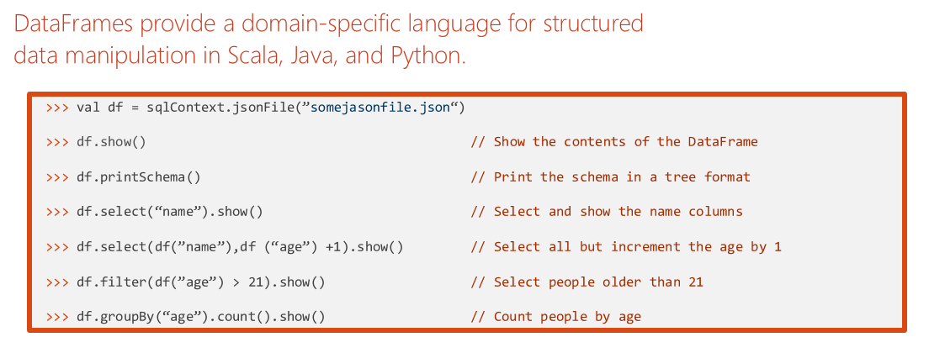
DataFrame Operations

Slide 15
What is Spark SQL?
Create an Azure storage account
HDInsight makes Apache Spark available as a service in cloud.
Run Spark SQL statements using notebooks
1
2
3
HDInsight uses Azure Blob storage account for storing data.
HDInsight makes Apache Spark available as a service in cloud.
You run interactive Spark SQL statements using notebooks.

Slide 16
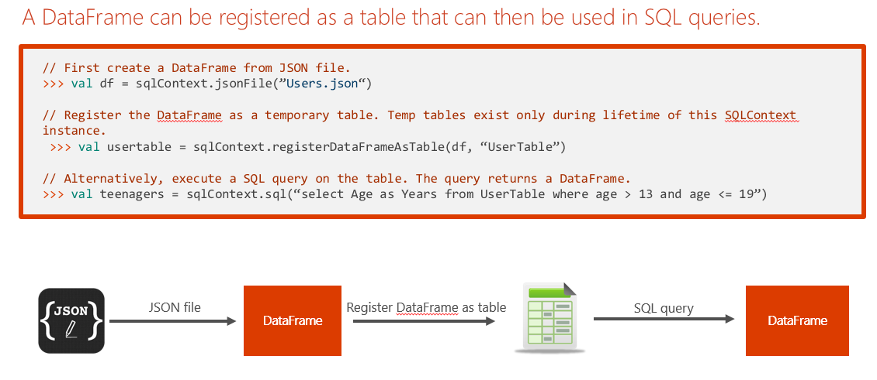
Tables and Queries

Slide 17
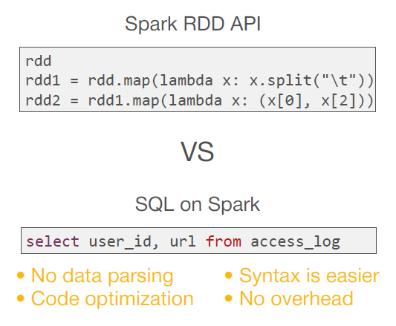
Spark SQL Operations

Slide 18
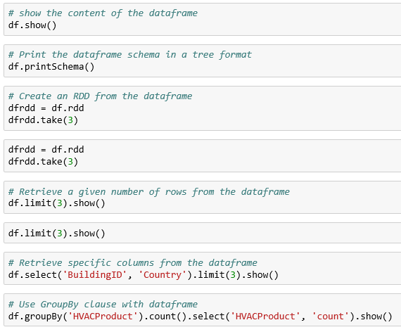
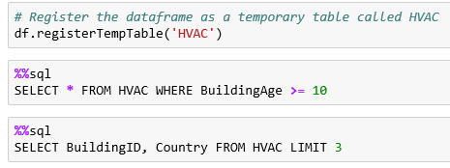
Demo: DataFrame and SQL
create a dataframe from a CSV file as shown below.
run SQL queries over dataframes once you register them as temporary tables within the SparkSession

Slide 19
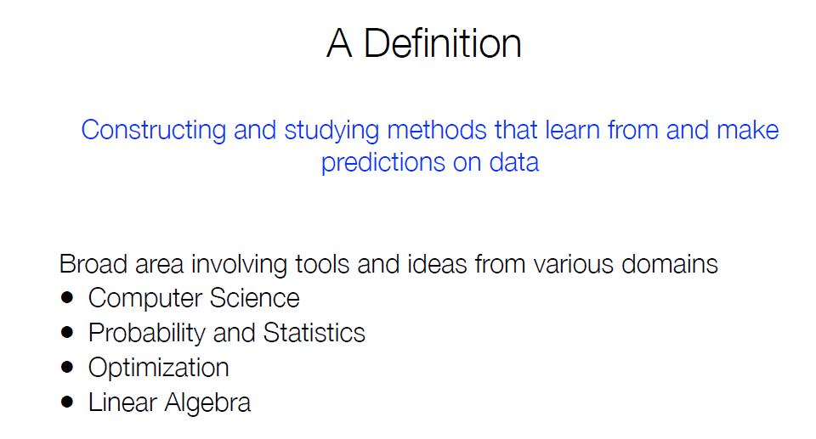
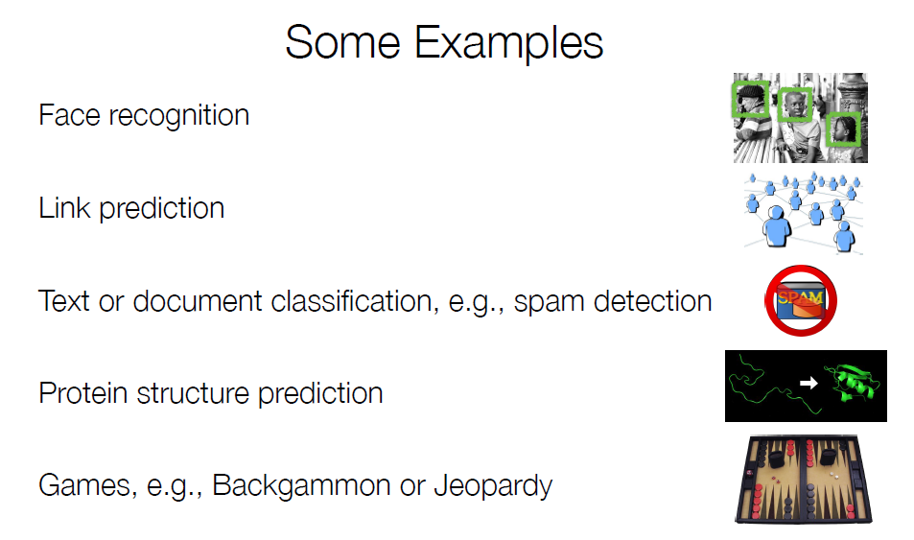
What is Machine Learning?

Slide 20
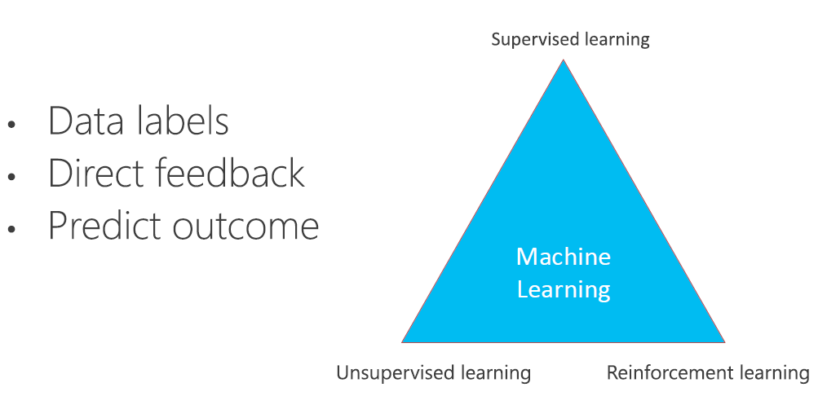
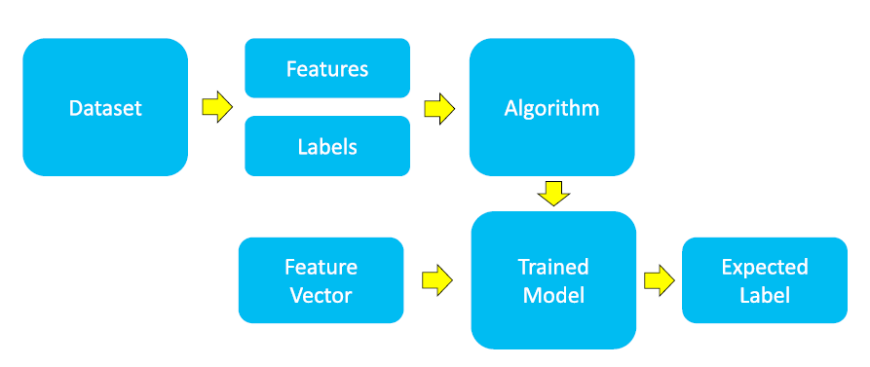
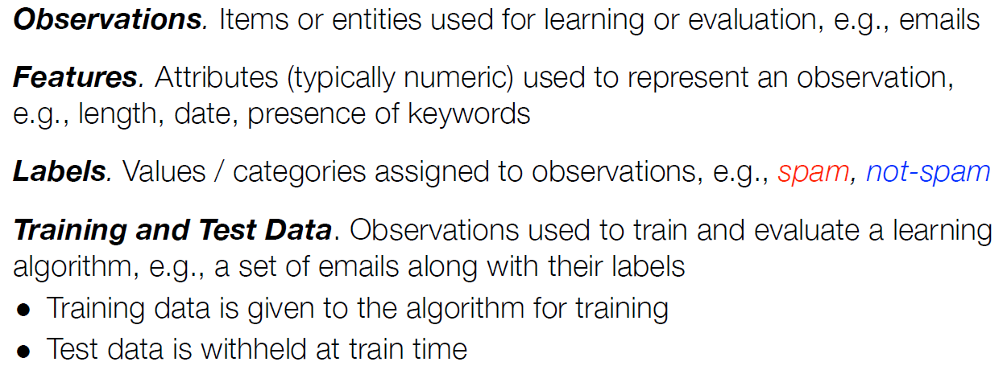
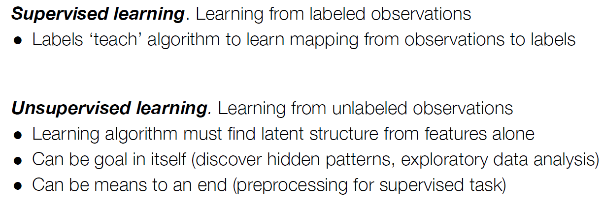
How does Machine Learning work?

Slide 21
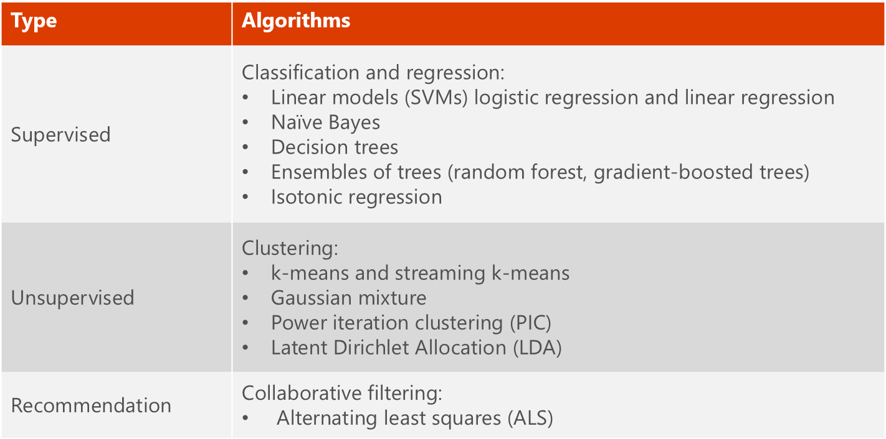
What is MLlib?
MLlib is a collection of machine learning algorithms optimized to run in a parallel, distributed manner on Spark clusters.
MLlib helps lead to better performance on large data sets.
MLlib integrates seamlessly with other Spark components.
MLlib applications are developed in Java, Scala, and Python.

Slide 22
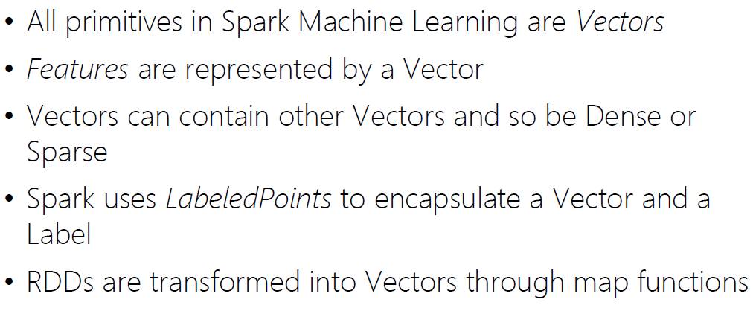
How to.. Machine Learning in Apache Spark?

Slide 23
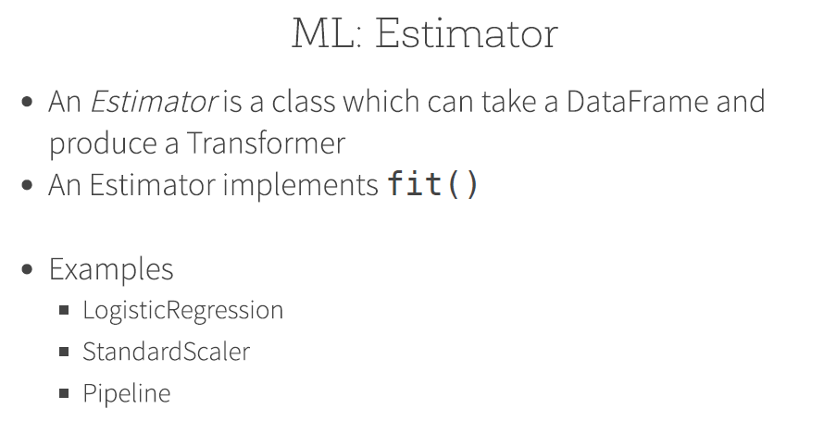
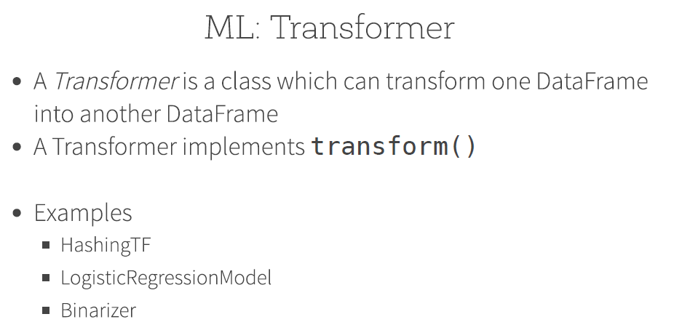
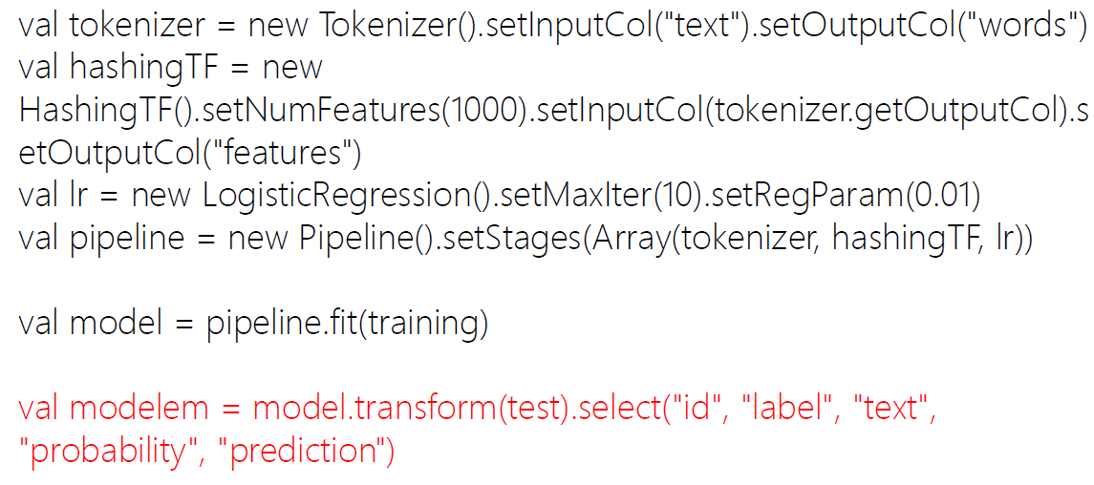
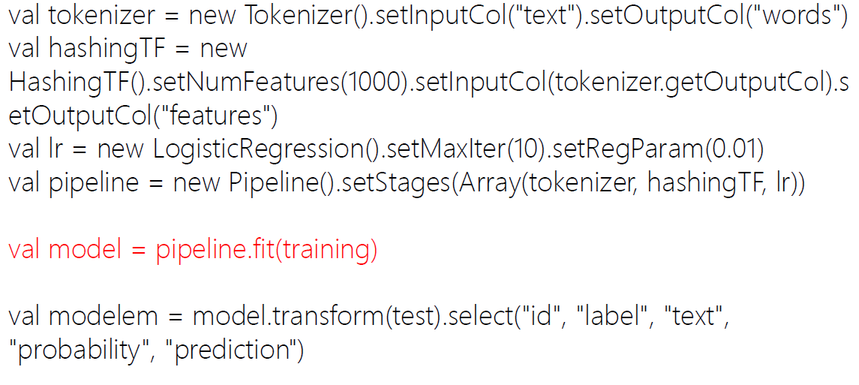
MLlib Terminology

Slide 24
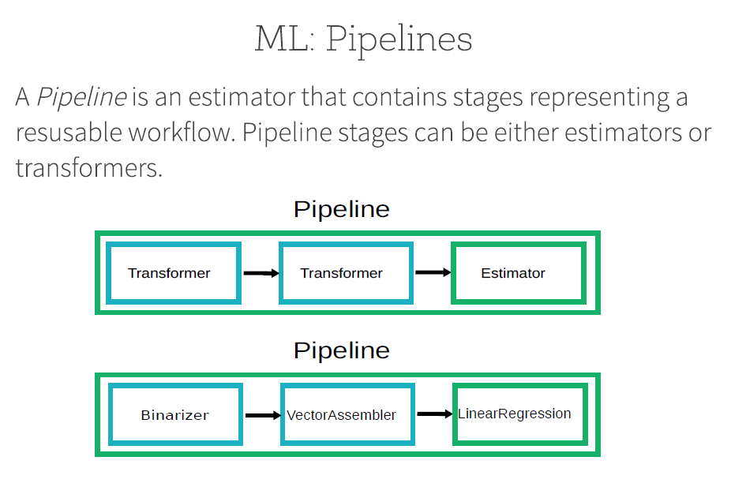
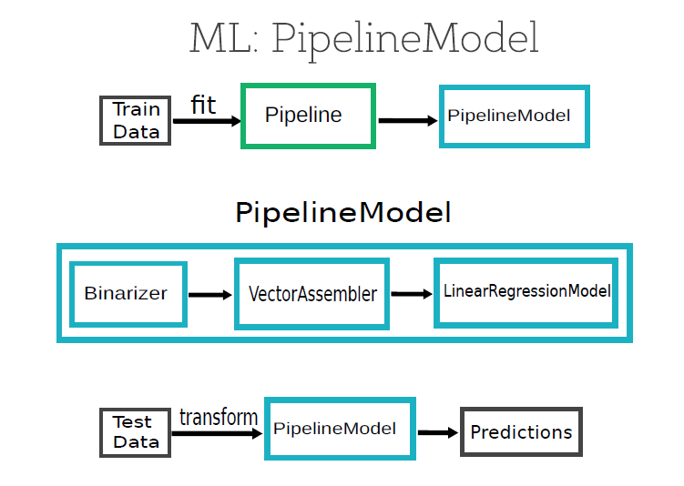
MLlib Terminology

Slide 25
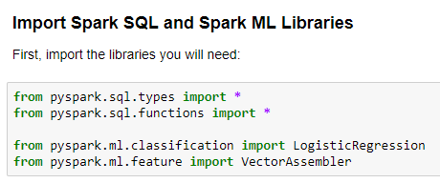
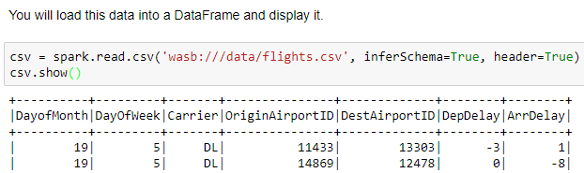
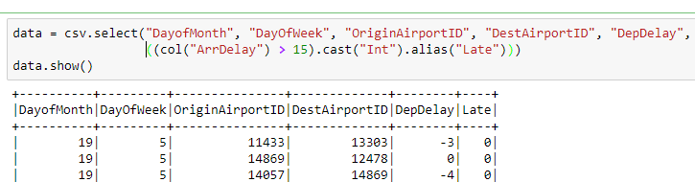
Example: Classification I
Step 2: Load Source Data
Step 3: Prepare the Data

Slide 26



Example: Classification II
Step 4: Split the Data
Step 5: Prepare the Training Data
Step 6: Train a Classification Model

Slide 27


Example: Classification III
Step 7: Prepare the Testing Data
Step 8: Test the Model

Slide 28



Example: Regression I
Step 2: Load Source Data
Step 3: Prepare the Data

Slide 29



Example: Regression II
Step 4: Split the Data
Step 5: Prepare the Training Data
Step 6: Train a Regression Model

Slide 30


Example: Regression III
Step 7: Prepare the Testing Data
Step 8: Test the Model

Slide 31



Example: Pipeline
Step 1: Define the Pipeline
Step 2: Run the Pipeline as an Estimator
Step 3: Test the Pipeline Model

Slide 32



Example: Text Analysis
Step 2: Run the Pipeline as an Estimator
Step 3: Test the Pipeline Model

Slide 33



Example: Clustering
Step 1: Create the K-Means Model
Step 2: Get the Cluster Centers
Step 3: Predict Clusters

Slide 34



Example: Recommendation I

Slide 35


Example: Recommendation II

Slide 36

Questions

